Slide 1
Paravertebral Region & Root Of Neck
Presented by :- Dr. Sushma Tomar
Associate Professor
Department of Anatomy

Slide 2
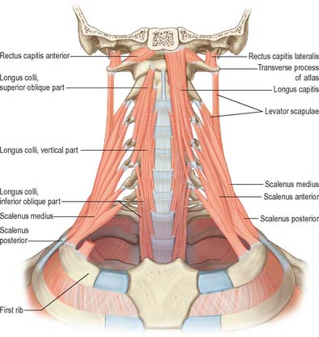
PARAVERTEBRAL (Lateral Vertebral )MUSCLES
Extend obliquely from transverse processes of cervical vertebrae to the upper two ribs.
Lie under cover of sternocleidomastoid.
Covered by prevertebral layer of deep cervical fascia.
Consists of:-
Scalenus posterior.
Scalenus medius.
Scalenus anterior.

Slide 3
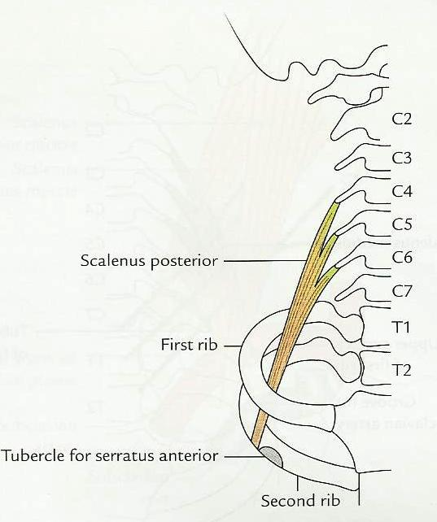
Scalenus Posterior
Smallest and most deeply situated muscle in this group.
ORIGIN-
Posterior tubercles of the transverse processes of C4, C5, and C6 vertebrae.
INSERTION-
Outer surface of the 2nd rib, behind the tubercle for Serratus anterior.
NERVE SUPPLY-
Anterior primary rami of lower three cervical (C6, C7, and C8) spinal nerves.
ACTIONS-
Bends the cervical vertebral column to the same side (when the 2nd rib is fixed).
Elevates the 2nd rib (when upper attachment is fixed).

Slide 4
Scalenus Medius
ORIGIN-
Posterior tubercles and costo-transverse bars of the transverse processes of C2- C6 vertebrae.
INSERTION-
Upper surface of the 1st rib, between the tubercle of the rib and groove for subclavian artery.
NERVE SUPPLY-
Anterior primary rami of C3-C8 spinal nerves.
ACTIONS-
Bends the cervical vertebral column to the same side (when the 1st rib is fixed).
Elevates the 1st rib (when upper attachment is fixed)- accessory muscle of respiration.

Slide 5
Scalenus Anterior
‘Key muscle’ at the root of the neck.
Most superficial and lies deep to Sternocleidomastoid muscle.
It is a useful ‘surgical landmark’.
ORIGIN-
Anterior tubercles of the transverse processes of all typical cervical (C3- C6) vertebrae.
INSERTION-
Scalene tubercle on inner border of the 1st rib.
Ridge on the upper surface of 1st rib separating the groove for subclavian artery posteriorly and groove for subclavian vein anteriorly.

Slide 6
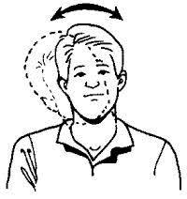
Scalenus Anterior contd…
NERVE SUPPLY-
Anterior primary rami of C4, C5, and C6 spinal nerves.
ACTIONS-
Flexion of cervical part of vertebral column.
Elevates the 1st rib-accessory muscle of respiration.

Slide 7
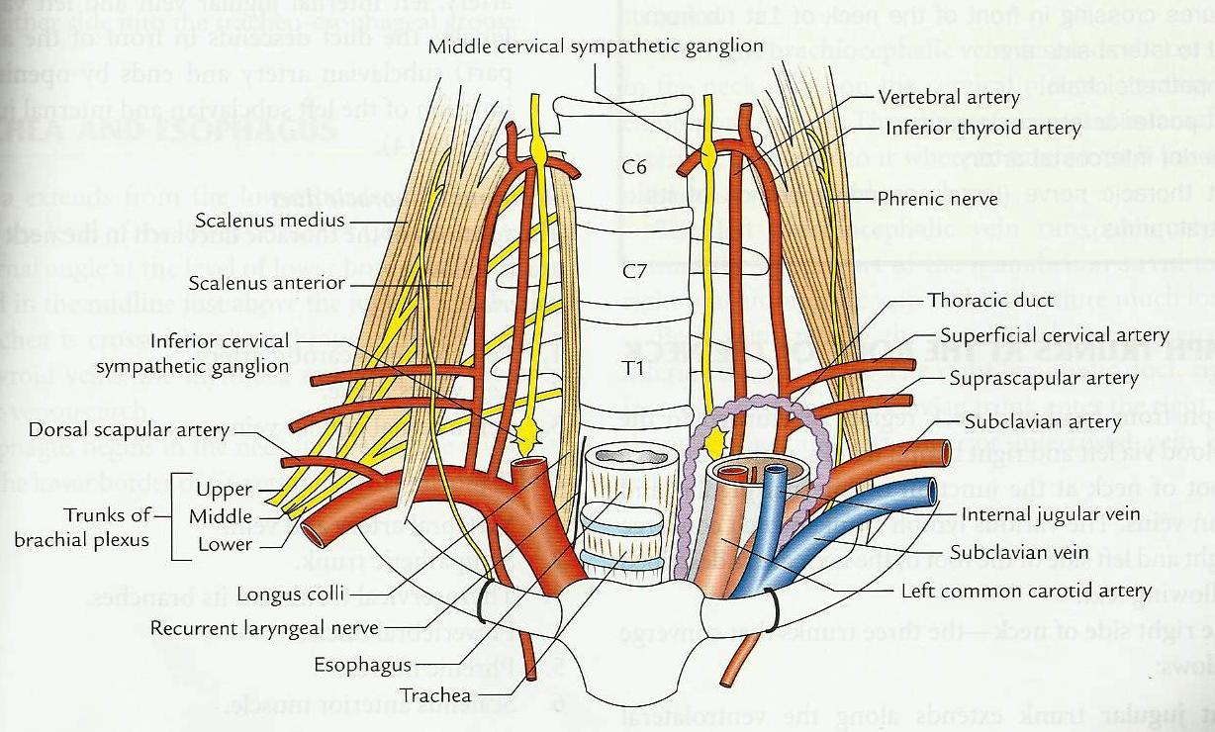
Relations of Scalenus Anterior
ANTERIOR-
One nerve-
Phrenic Nerve.
Two arteries-
Suprascapular artery.
Transverse cervical artery.
Two veins-
Anterior jugular vein.
Subclavian vein.
Two muscles-
Inferior belly of omohyoid.
Clavicular head of Sternocleidomastoid
Carotid sheath.
Clavicle bone.

Slide 8
Relations of Scalenus Anterior contd…
POSTERIOR-
Roots of brachial plexus.
2nd part of Subclavian artery.
Scalenus medius muscle.
Cervical pleura.
Suprapleural membrane.

Slide 9
Scalene Triangle
LOCATION-
Above the first rib between Scalenus anterior and Scalenus medius muscle.
CONTENTS-
Trunks of brachial plexus.
Subclavian artery.

Slide 10
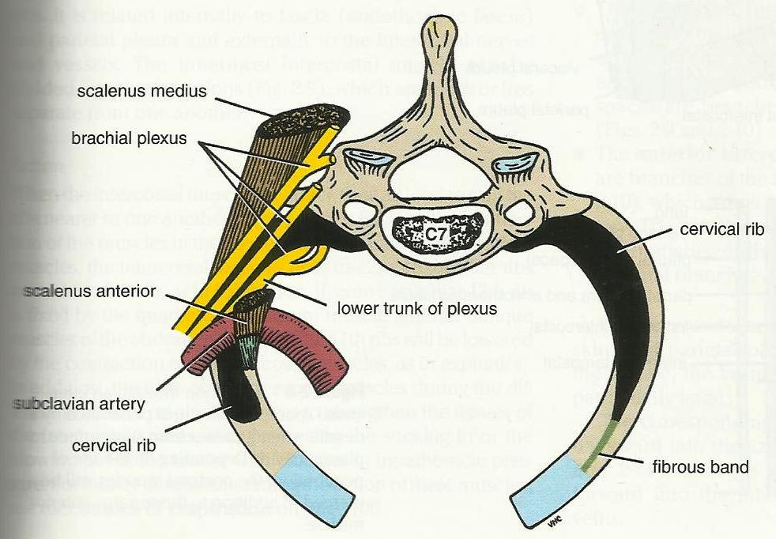
Cervical Rib
Costal elements of 7th cervical vertebra undergo abnormal development and form cervical rib.
Cervical rib arises from anterior tubercle of transverse process of 7th cervical vertebra.
Occurs in less than 0.5% of population.
Cervical rib may have free anterior end, may be connected to the 1st rib by a fibrous band or may articulate with the 1st rib.

Slide 11
Cervical Rib contd…
Complete cervical rib passes laterally and forward between the Scalenus anterior and Scalenus medius muscles and joins with the first rib close to the insertion of scalenus anterior.
More often it is unilateral.
More frequent on the right side.
Lower trunk of brachial plexus arches over the cervical rib.

Slide 12
Scalene Syndrome
Occurs due to compression of lower trunk of brachial plexus (C8 and T1) and Subclavian artery in the scalene triangle.
ETIOLOGY-
Cervical rib.
Spasm of scalene muscles.
CLINICAL PRESENTATION-
Due to compression on lower trunk of brachial plexus:
Sensory loss of medial one and half fingers of the hand and part of forearm.
Tingling sensation and numbness along the inner border of forearm and hand.
Progressive paresis and wasting of hypothenar muscles of the hand.
Due to occlusion of Subclavian artery:
Ischemic pain and absence of radial pulse

Slide 13
Scalene Syndrome contd…
Compression of Subclavian artery may result in an aneurysm, which is a potential source of emboli to the hand.
Emboli may cause gangrene of the finger tips.
LOCAL COMPLICATIONS-
Tender supraclavicular lump which is bony hard and fixed.

Slide 14
Scalenovertebral Triangle OR Triangle of Vertebral Artery
A deeply placed triangular space at the root of the neck.
BOUNDARIES-
Medial-
Inferior oblique part of Longus colli.
Lateral-
Medial border of Scalenus anterior.
Apex-
Transverse process of C6 vertebra.
Base-
1st part of subclavian artery.
.

Slide 15
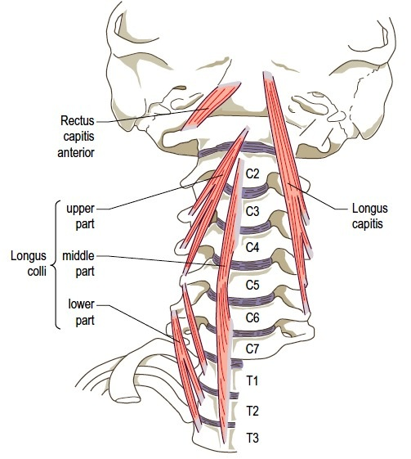

Slide 16
Boundaries of Scalenovertebral Triangle contd…
Floor-
Transverse process of C7 vertebra.
Ventral ramus of C8 spinal nerve.
Neck of 1st rib.
Cupola of cervical pleura.
Roof-
Carotid sheath

Slide 17
SCALENOVERTEBRAL TRIANGLE CONTD…
CONTENTS-
1st part of vertebral artery.
Thyrocervical trunk.
Inferior thyroid artery.
Sympathetic chain with stellate ganglion.
Ansa subclavia.

